Slide 1
Budweiser Data Analysis Project
Reed & Miller Consulting

Slide 2
Brewery Count By State
Summary statistics
Total breweries counted = 558
Top 10 = ~51% of total count
Top 5 = ~31% of total count

Slide 3
Addressing Missing Data / NA’s
Only 2 of 10 categories evidenced missing data / NA’s.
Alcohol by volume of the beer (ABV) = 62 missing values (3% of total)
International Bitterness Units of the beer (IBU) = 1005 missing values (42% of total)
What will be done with this data?
For now we will keep them in the analysis but:
May need to be filtered out later to avoid misleading results
May be removed if we can determine whether the data is missing at random or not

Slide 4
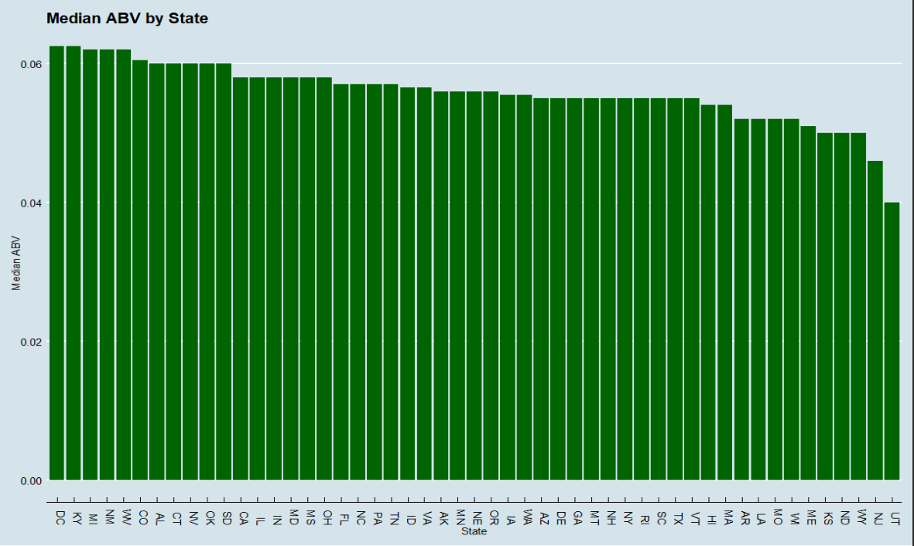
Median Alcohol By Volume (ABV)

Slide 5
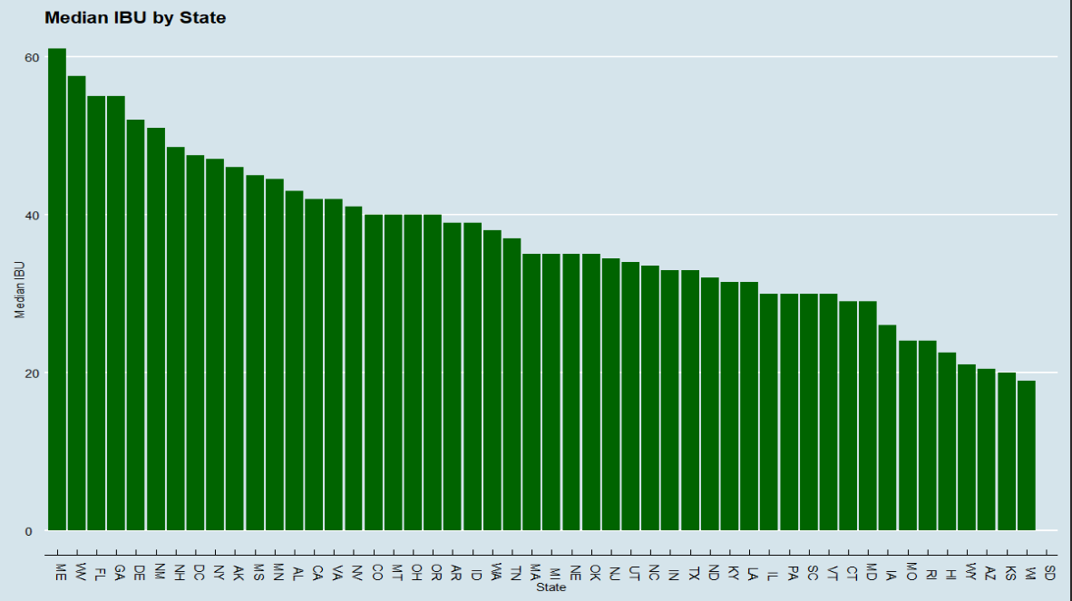
Median International Bitterness Units (IBU)

Slide 6
Maximum ABV/IBU Beer
The beer with the Highest ABV is the “Lee Hill Series Vol. 5 - Belgian Style Quadrupel Ale”, which comes from a brewery in Colorado and has an ABV of 12.8%.
The beer with the Highest IBU is the “Bitter Bitch Imperial IPA”, which comes from a brewery in Oregon and has an IBU of 138.

Slide 7

ABV Summary Statistics
As we can see, the mean is relatively close to the median and a 20% trimmed mean.
This tells us that there are not a significant number of outliers and/or they are not very extreme.

Slide 8
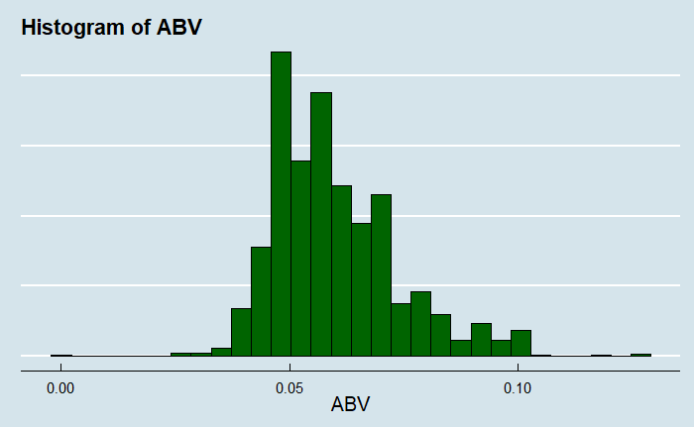
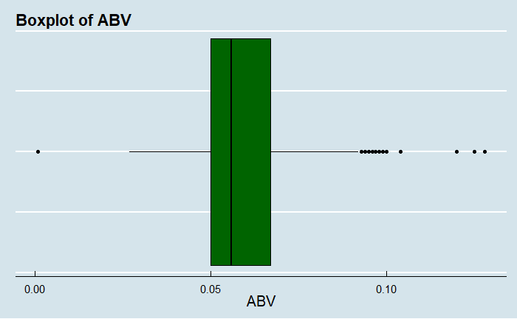
ABV Distribution
The histogram and boxplot appear slightly right skewed. This indicates there is a group of beers that have a higher-than-normal ABV.
The boxplot shows these outliers, and they tend to be IPAs as one would expect.
In the 4th quartile of the boxplot, 50.7% of the beers are IPAs, while IPAs only make up 23.8% of all beers in this study.

Slide 9
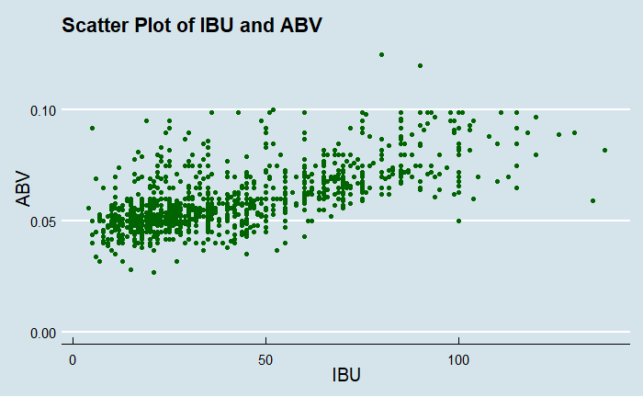
IBU/ABV Correlation
The graph shows a positive correlation between the two variables.
The Pearson Correlation Coefficient is .67 which also indicates a strong positive relationship between IBU and ABV.
In general, it appears that as a beer increases on the International Bitterness Units (IBU) scale, the Alcohol by Volume (ABV) also increases in a linear fashion.

